Slide 1
SMART PLANT MONITORING SYSTEM USING IOT
Under guidance of
Dr. SANGEETHAA S N ,
ASSISTANT PROFESSOR-II,
DEPARTMENT OF CSE,
BANNARI AMMAN INSTITUTE OF TECHNOLOGY,
SATHYAMANGALAM.
201CS207-LAKSHANA S
201CS243-POORNIKA SRI G
201CS305-SUBHASHINI S V
201EI141-THARANIYA S

Slide 2
Abstract
From early man stage to the right now scenario , agriculture plays an important role in each and everyone’s life. We call its as a backbone of our country as it fulfils the basic requirements for each and everyone as of food or cloth materials. The raw materials are owned from agriculture. I hope so our idea is going to make some innovative thing in agriculture and to the farmers. Our idea is about Smart Plant Monitoring System which includes the monitoring of soil temperature, soil moisture and humidity. We can also control the water flow with our smartphone anywhere around the world. Here we are constructing a IoT primarily based Irrigation System the use of ESP8266 NodeMCU Module and DHT11 Sensor. It will not only routinely irrigate the water primarily based on the moisture level in the soil but also send the Data to ThingSpeak Server to maintain tune of the land condition.
STEP 1 – BLOCK DIAGRAM OF THE PROJECT Do the connection of sensors, BOLT and relay as given in diagram. I have used 328p microcontroller which is used in ARDUINO. So you can use Arduino in place of 328P microcontroller.
STEP 2 – AURDINO CODE FOR PROJECT. Hardserial.inoo is arduino code which consist of interfacing of unique sensors with arduino and interfacing of Arduino with BOLT to send information of sensor on BOLT cloud page.
STEP 3 – CODING OF HTML PAGE. In this step, we will code the HTML page through which we send command to Arduino for controlling the motor(i.e., to START and STOP the motor). The other steps includes uploading JAVASCRIPT ON BOLT CLOUD, configuration on BOLT CLOUD PAGE and deploy CONFIGURATION and DATA VISUALISATION. Therefore , IOT creates a new innovative platform in the agriculture field and also the water gets saved by using this innovative technique.

Slide 3
Problem Statement Addressed
• In the case of traditional irrigation system water saving is not considered.
•Since, the water is irrigated directly in the land, plants under go high stress from variation in soil moisture, therefore plant appearance is reduced.
•The absence of automatic controlling of the system result in improper water control system.
•The major reason for these limitations is the growth of population which is increasing at a faster rate. •So this is the serious problem in agriculture area.

Slide 4
Existing Solution to the Problem Addressed
The existing solution is that the soil moisture sensor is being fixed at particular level in the soil. And it recognizes the soil moisture level whether the land is to be irrigated or not.
But in addition to that we have used one more advantage of alerting the particular owner of the land with alert message or through app notifications. And also if there is no internet facilities /tower problems, the person will get some alarm signals which will be connected with soil moisture sensor.

Slide 5
Proposed Solution to the Problem Addressed
Here we are constructing a IoT primarily based Irrigation System the use of ESP8266 NodeMCU Module and DHT11 Sensor.
It will not only routinely irrigate the water primarily based on the moisture level in the soil but also send the Data to ThingSpeak Server to maintain tune of the land condition

Slide 6
Project Work Plan
In this project we will command the microcontroller through a web page to control the motor.
The only work the user has to do is to start the motor and the following automated condition will work
1)The motor pump will automatically get switched off once the soil moisture sensor has reached the threshold value
2)If the weather condition is such that it started raining, then the microcontroller will shut down till it is raining and start again automatically
3)Also incase, when power supply gets cut off and motor gets switched off and it will restart again automatically

Slide 7
Project Work Plan
The data of the various sensors like moisture sensor,humidity sensor and temperature sensor will be displayed on the BOLT cloud webpage in graphical form that make the track on the farm by the farmer
The sensor monitoring system will be charged
automatically by solar power plate on it and also it
possesses battery which works during the non sunny
days and rainy days .The web page will ask for
password making the process more secure and
privacy

Slide 8
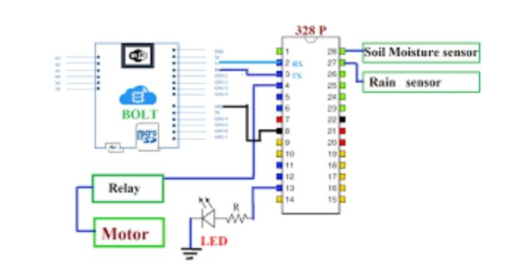
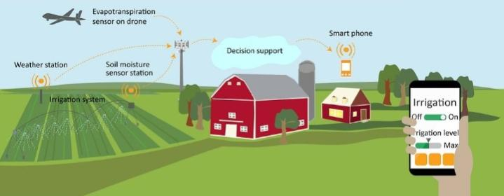
Block Diagram and/or Circuit Diagram

Slide 9
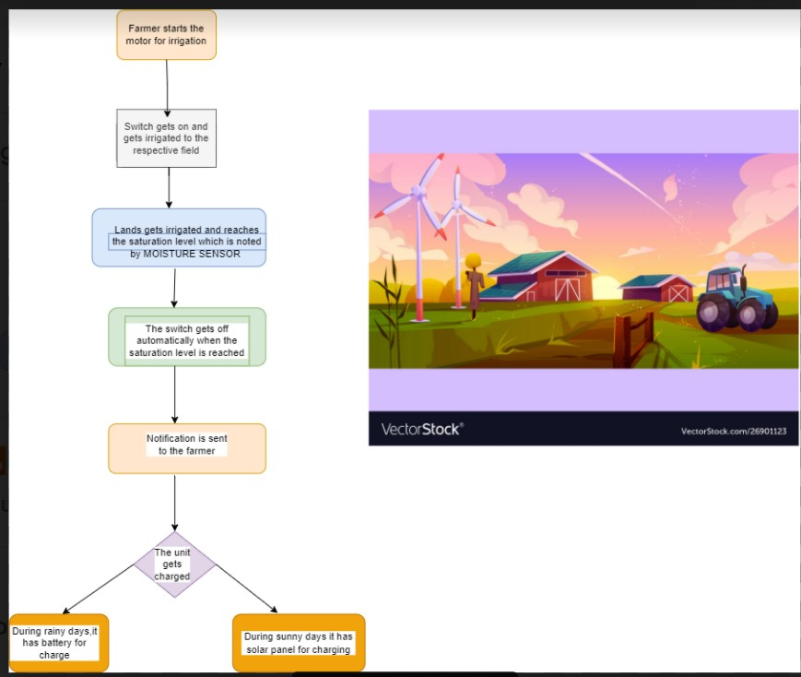
Flow Chart

Slide 10
Effective utilization of the Modern Tool & Cloud
STEP 1: Do the connection of sensors, BOLT and relay as given in diagram. I have used 328p microcontroller which is used in ARDUINO. So you can use Arduino in place of 328P microcontroller.
STEP 2: Hardserial.ino is arduino code which consist of interfacing of unique sensors with arduino and interfacing of Arduino with BOLT to send information of sensor on BOLT cloud page.
STEP 3: In this step, we will code the HTML page through which we send command to Arduino for controlling the motor(i.e., to START and STOP the motor).
STEP 4 : UPLOADING JAVASCRIPT ON BOLT CLOUD
STEP 5 : CONFIGURATION ON BOLT CLOUD PAGE
STEP 6 : DEPLOY CONFIGURATION AND DATA VISUALISATION

Slide 11
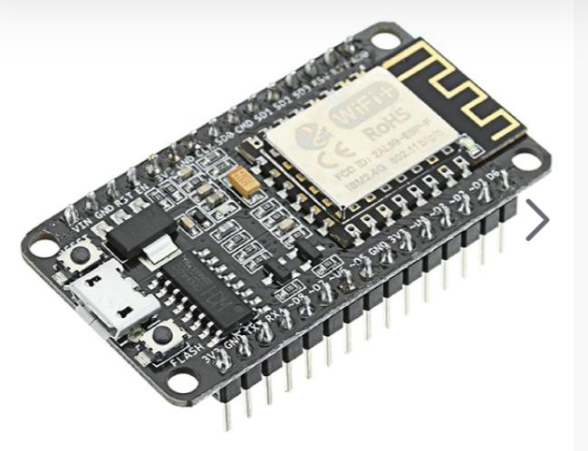
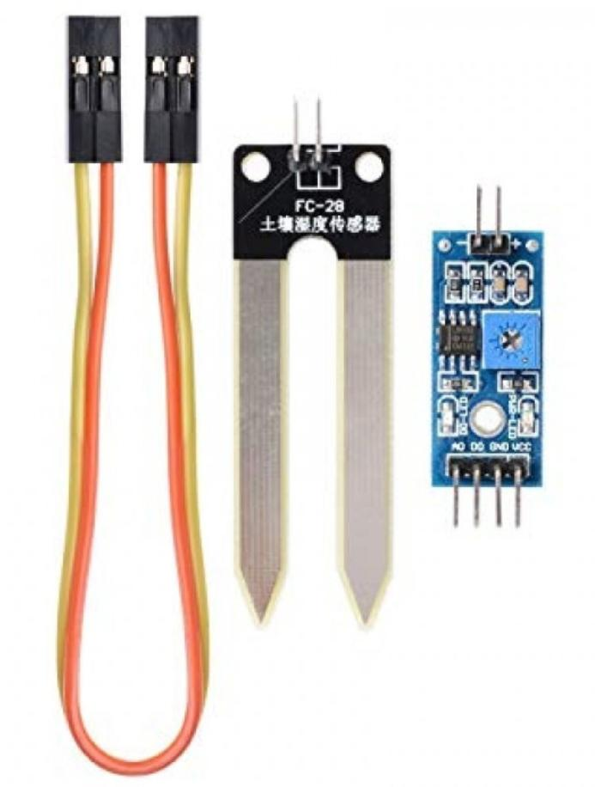
Technology stack & use case
Nodemcu ESP8266 •SOIL MOISTURE SENSOR

Slide 12
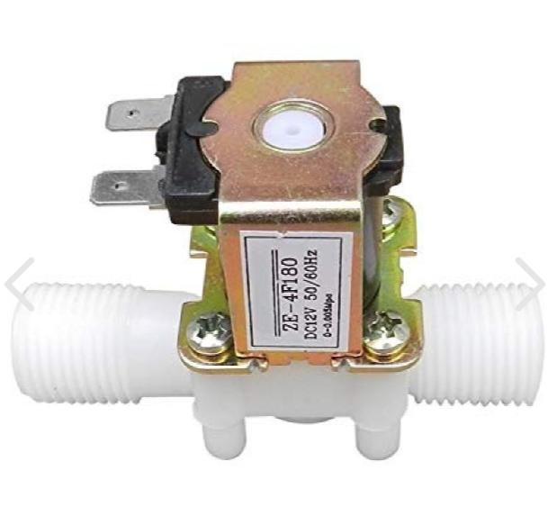
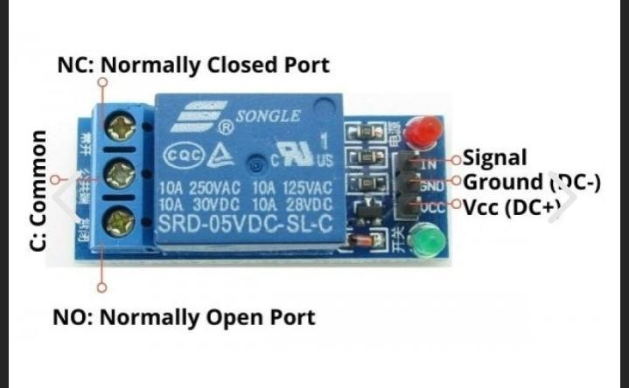
Technology stack & use case
RELAY MODULE •SOLENOID WATER VALVE

Slide 13
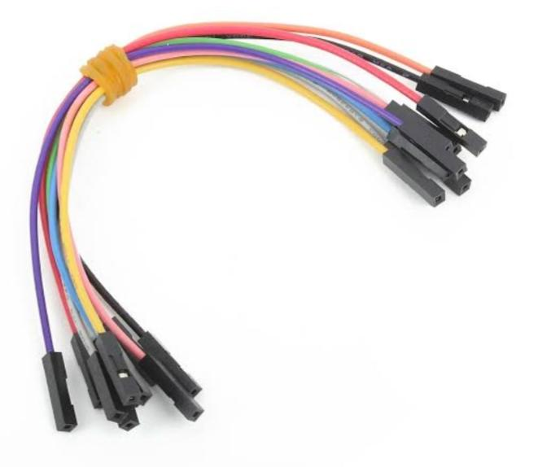
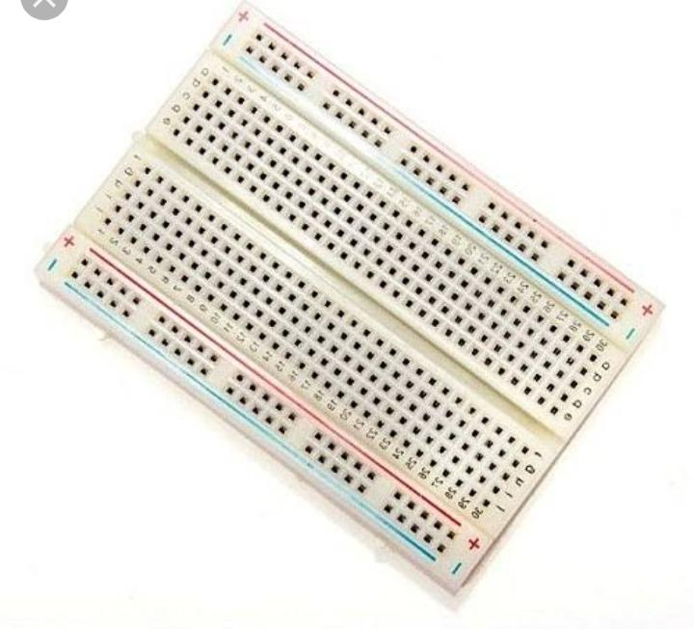
Technology stack & use case
BREADBOARD • JUMPERS

Slide 14
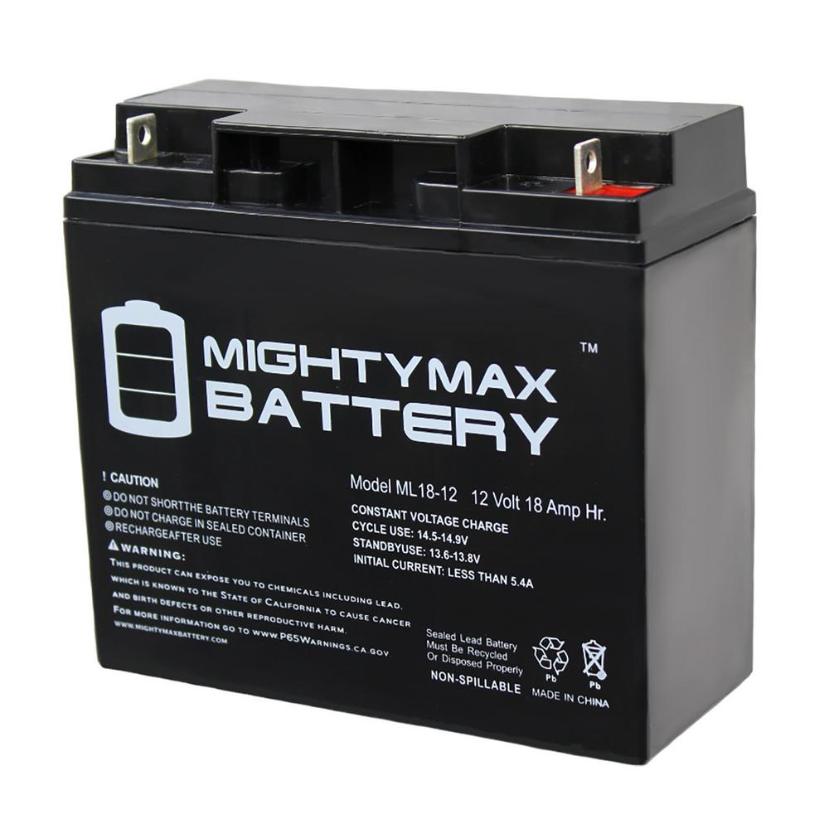
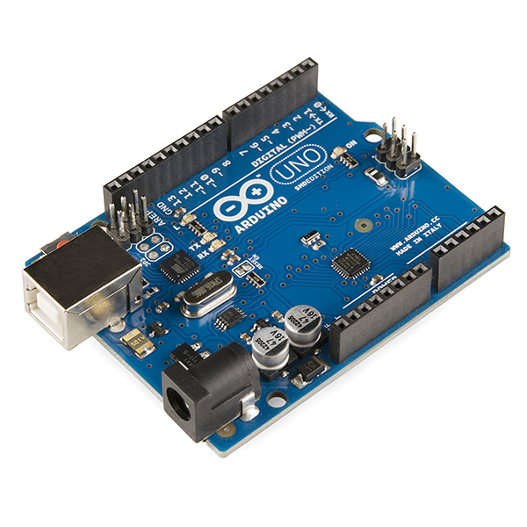
Technology stack & use case
12 V BATTERY. • AURDINO

Slide 15
Technology stack & use case
• The idea of smart plant monitoring system was an extract from the already existing work but the existing work needs some more attention and correction to be done.
• The first and foremost disadvantage is the cost which is of 8000-9000 in the market range.
• This is due to the usage of components in high level
• But in our work, we use high level of components in low cost and the estimated amount is 2000 -3000.
•So it’s profitable for the farmers demand and also to us.
•The second thing is the most important one security which is not present in the existing product. But in this work, we use privacy security which allows the user and their family members to access without the threat of the third person.
• And the main thing is the product should be nature-friendly one which should not harm or pollute our nature. So, ours will serve as the best one in this part.
•Last but not least, Water is the most necessary one to all the living beings. So, in this case water is conserved without much wasting.

Slide 16
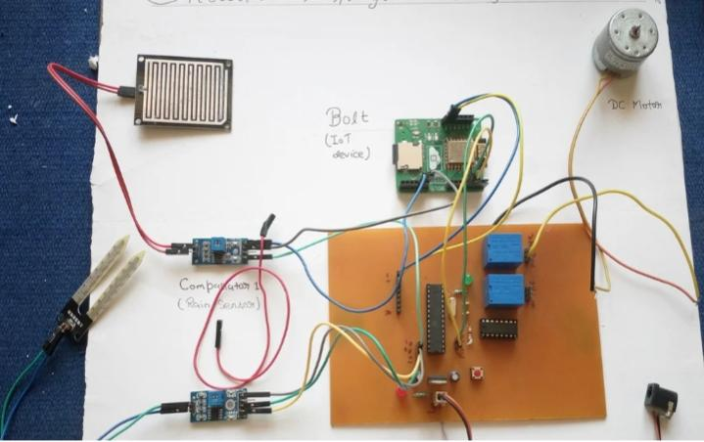
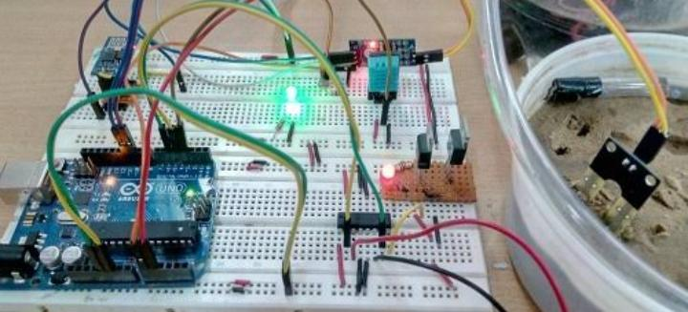
Prototype & Sample Output

Slide 17
Analysis of Results & Discussions
Our project automates the irrigation process which is one of the most time efficient activities in farming which prevents over irrigation and under irrigation thereby preventing crop damage.
It also conserves water for irrigation by locating the sensor at the right level above the soil.
The user can monitor process online through the website,the development of 5G technology and space based internet can soon solve the reliable internet related issues in remote areas

Slide 18
Cost Benefit Analysis (List of Components / Service Used)
S.No | Component Name | Specification (IC number or Range or Value) | Unit Cost | Total Cost
1. | SOIL MOISTURE SENSOR | LM393IC | 137 | 137
2. | Nodemcu ESP8266 | 74hc4051 | 190 | 190
3. | RELAY MODULE | - | 300 | 300
4. | SOLENOID WATER VALVE | - | 305 | 305
5. | AURDINO | ATmega328P | 699 | 699

Slide 19
Working video Link (If available)
Video is not available..

Slide 20
References
[1]http://www.ewaterautosys.com/water-automation-system.html
[2]http://www.wplawinc.com/agricultural-irrigation-blog/the-most-common-problems-with-farm-irrigation-systems
[3] https://www.pwc.com/us/en/increasing-it- effectiveness/assets/future-of-the-internet-of-things.pdf
[4] IOT based Smart Irrigation System SrishtiRawal Department of Computer Science,
VIT University rawal-2017-ijca-913001.pdf
[5] Thingspeak : https:// thingspeak.com

